Slide 1

HyDeploy Webinar
Unlocking the deployment of hydrogen in the grid
20 May 2020

Slide 2





Agenda
Welcome
  Andy Lewis (Cadent)
Introductory video
Project overview
  Dr Chris Manson Whitton (Progressive Energy Ltd)
Customer perspective
  Prof Zoe Robinson (Keele University)
Question & Answer session
  Consortium panel
  All questions via the ‘chat’ function

Slide 3


Slide 4
Project Overview
Dr Chris Manson-Whitton
Progressive Energy Ltd

Slide 5

The Energy landscape and the role for hydrogen blending
Hydrogen blending means…
  No change for consumers
  Hydrogen supply chain development
  Carbon savings equivalent to 2.5 million cars off the road
  Deliverable roadmap for deeper savings
Heat dominates UK energy consumption compared with electricity
Committee on Climate Change
Identifies that hydrogen is a ‘necessity’, and that grid blending has a key enabling role
Based on UK Energy Consumption Data 2019, BEIS

Slide 6

Project Objective and Timeline
To enable bulk deployment of hydrogen blending within the UK gas network by demonstrating its safe transportation and use.
Safety Case
Install
Trial @ Keele
Safety Case
Install
NE Public Trial
Safety Case
Install
NW Public Trial
2017 2019 2021 2023
Project Funded under OFGEM’s Network Innovation Programme

Slide 7



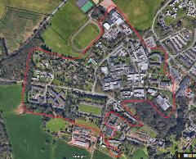
Exemption
Safety Case
Install
Trial
It is not permitted to transport hydrogen in the grid above 0.1% _{vol} in the UK
Exemption to GS(M)R is required to transport blended gas.
Must show that “persons affected by the exemption, will not be prejudiced in consequence of it.”
Evidence required to demonstrate 20%_{vol} hydrogen is ‘as safe as’ natural gas
Quantitative Risk Assessment backed by rigorous evidence
Great Britain
Keele University
‘as today’
Keele University
‘in trial’
H₂-NG
Secured the UK’s first hydrogen exemption in November 2018

Slide 8
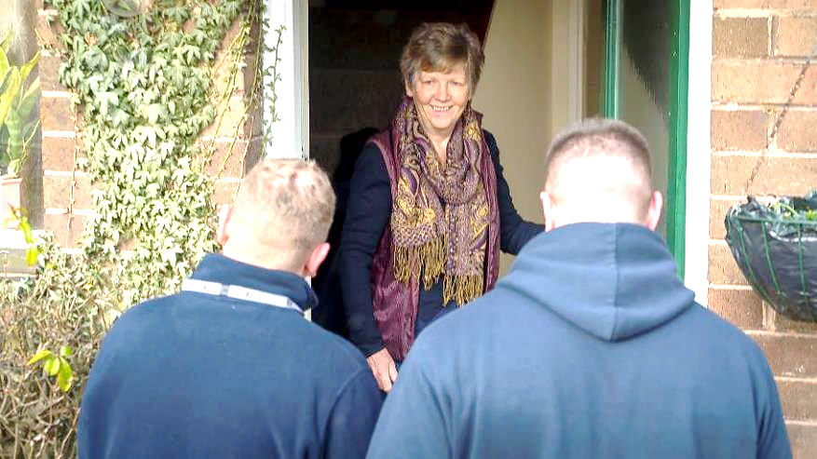
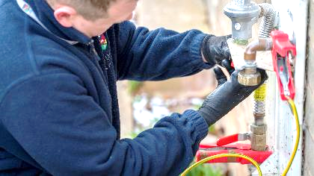
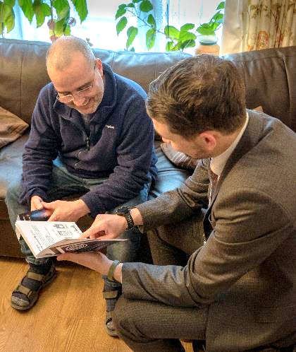

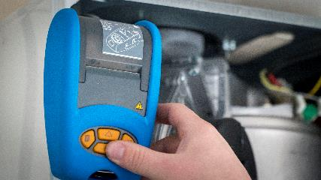
Customer Focused
Safety Case
Install
Trial

Slide 9

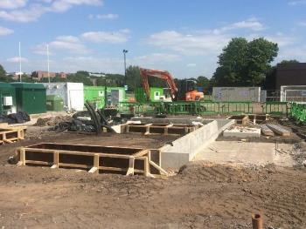
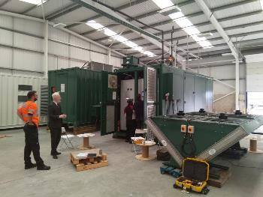
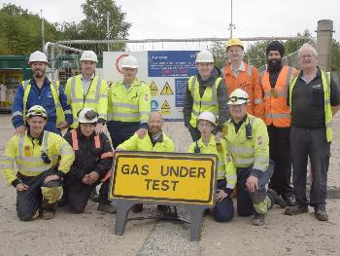
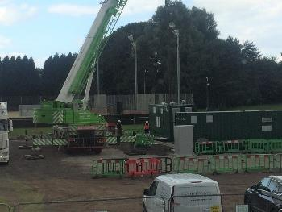
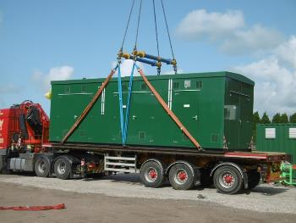
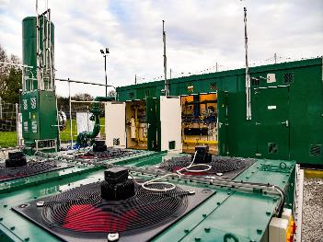
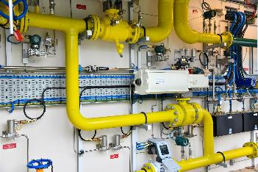
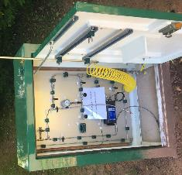
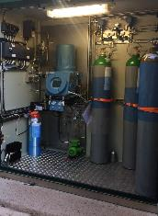
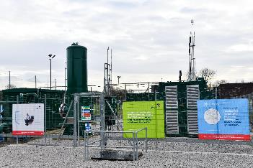

Installation
Safety Case
Install
Trial

Slide 10
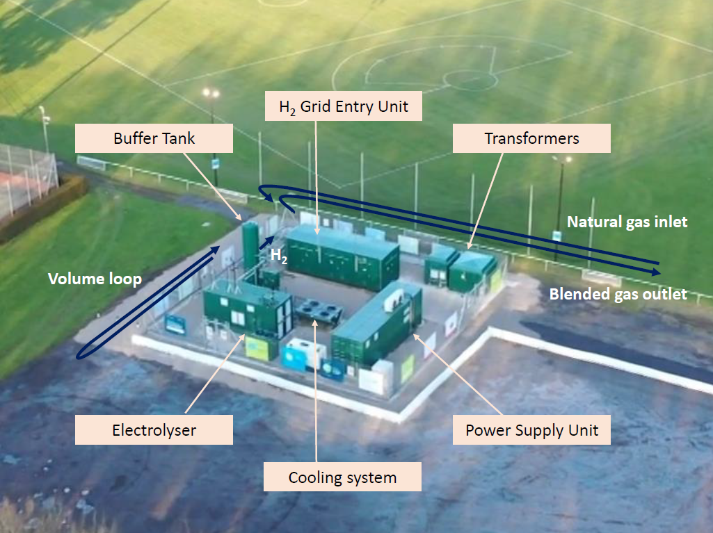
Hydrogen Facility
Safety Case
Install
Trial

Slide 11
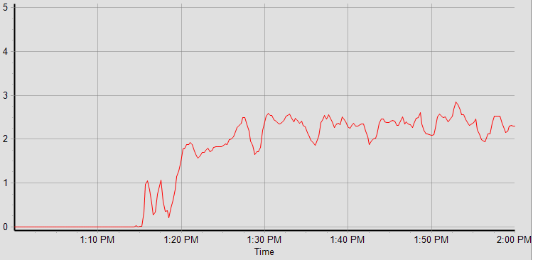
Trial Start
Safety Case
Install
Trial
Rigorous assessment process to increase blend level
Blend Level (%)
Combustion checks
Governor checks
Compound review
13:15 on 30 October 2019 Keele become the UK’s first gas network to operate above 0.1 %_{vol} hydrogen.
Composition (GC)
Composition (Lab)
Rhinology
Network Review
Flue gas checks

Slide 12
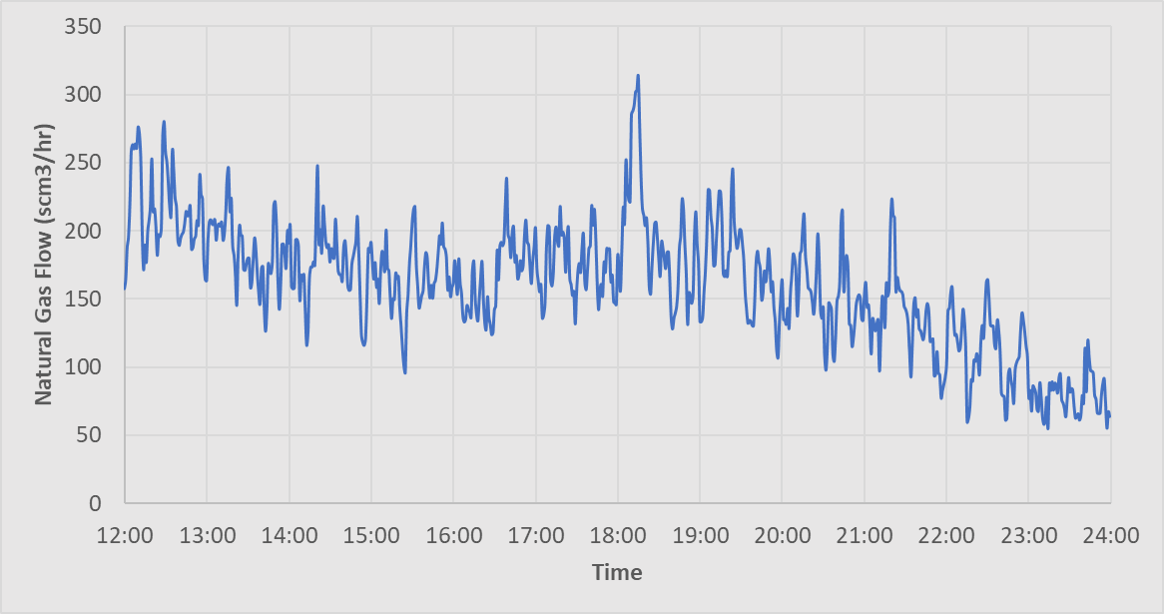
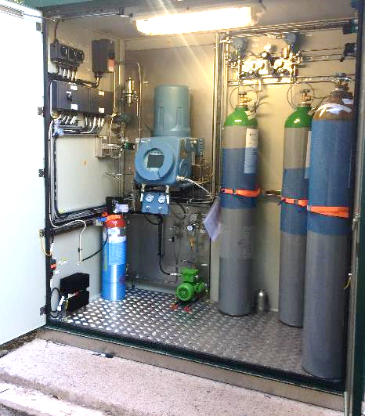
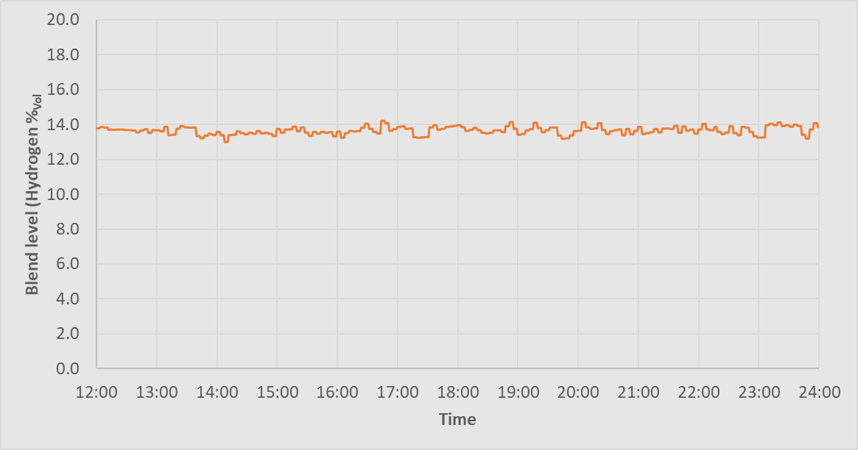
Blend Level Control
Safety Case
Install
Trial
Rapid gas flow change
Total gas flows
Blend level on Network

Slide 13
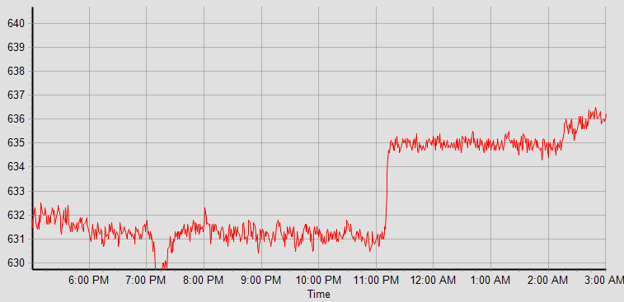
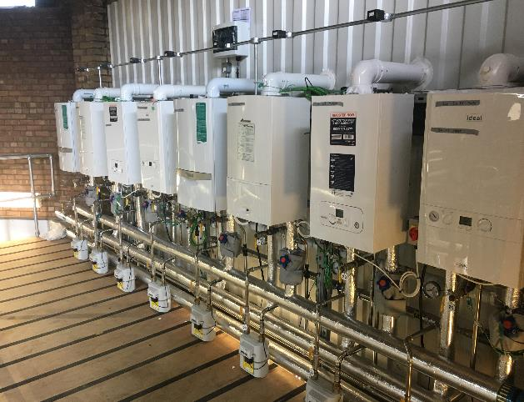
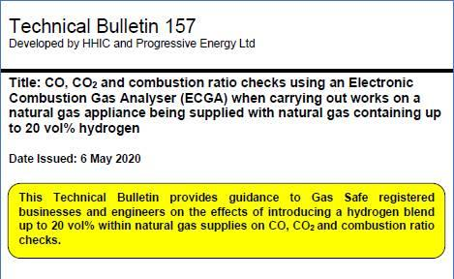
Test facility
Safety Case
Install
Trial
Burner temperature
Operation in line with laboratory data
All flue gas analysis passed on all blend levels

Slide 14
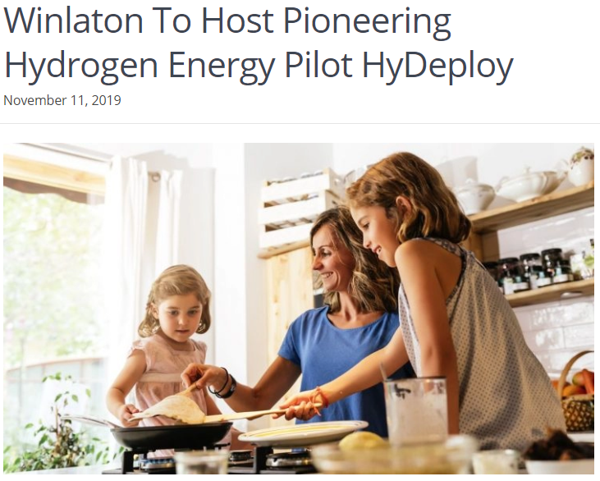
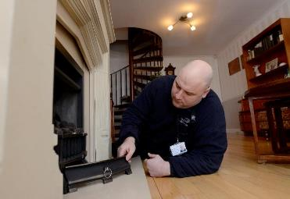
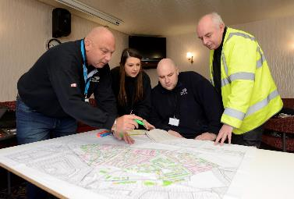
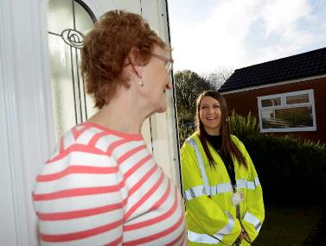

First Public Demonstration Programme underway
Isolated Network in the North East with 669 Properties
Using NGN’s Low Thornley Site for hydrogen injection

Slide 15
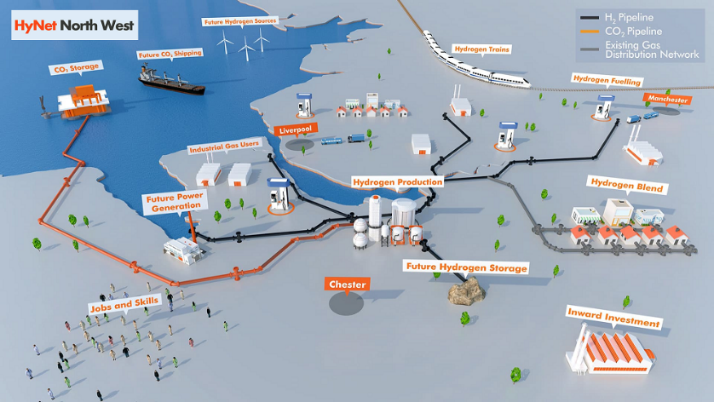

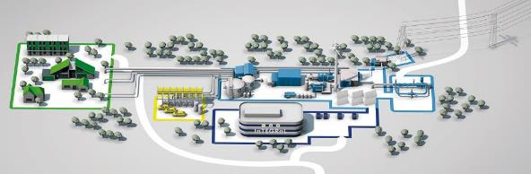
Deployment
HyDeploy provides the platform for the rapid physical deployment
of hydrogen in the gas network at scale.

Slide 16

Customer perceptions of receiving hydrogen-blended gas in the home:
Pre-blending results
Professor Zoe Robinson
Keele University
Co-authors:
Dr Phil Catney and Adam Peacock, Keele University
Professor Marylyn Carrigan, Herriott Watt University
Professor Victoria Wells, York University

Slide 17
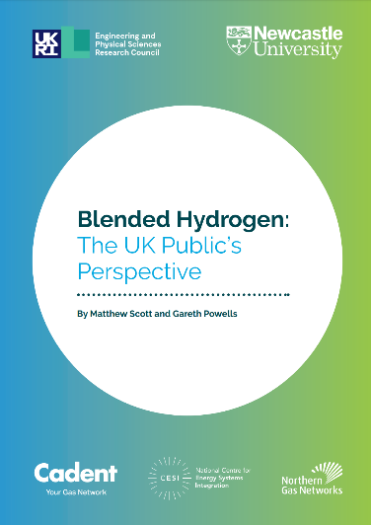
Aim of this research
To explore perceptions of customers taking part in the HyDeploy pilot
A two-stage research process
  Pre-demonstration (presented here)
  During/post-demonstration (data collection late summer)
Rationale:
Social acceptance is a key part of technical energy transitions.
The Keele demonstration provides an opportunity to learn from customers experiencing a hydrogen blend in their own home.
Notes:
Technical transitions – socio-economic implications
Acceptance that need consumers onside
We already know about what people think about hydrogen

Slide 18
Methodology
Qualitative approach for greater depth of understanding of experience and perceptions
Interviews – June 2019
  15 households on HyDeploy network
  1 campus resident, chair of Residents’ Association
  Interviews until data saturation met
Interviews explored: environmental views; energy behaviours; knowledge and attitude of hydrogen; views of being part of pilot and communication strategy.

Slide 19
Characteristics of sample
Mixed sample in terms of:
Gender
Housing tenure
Age of participants
Length of time in property
Resident links to Keele:
Employee
Partner of employee
Former employee
Notes:
Notes on Keele residents
not necessarily because of greater ‘scientific literacy’ than the average public, nor were many resident interviewees particularly scientifically literate or scientifically engaged.

Slide 20
Results: key areas
What did people think about taking part in the demonstration?
Concerns, reassurances and trust
Communications

Slide 21
1) What did people think about taking part in the demonstration?

Slide 22
1.1 Generally (very) positive views about taking part
The majority of participants were supportive of the demonstration – more than just ‘acceptance’.
“I was really positive about it, I thought it was an excellent thing, yeah.”
Some genuine excitement about being part of it:
“Just excited. I was excited as you can be about hydrogen gas.”
“You’re part of it. Stuck with it. I feel like a balloon was, like, swelling up in my chest, I was very proud.”
Notes:
Support – active, positive attitude towards development and implementation
Some increased pride – one of first contributing to new developments
Would have taken part anyway even if didn’t have to
Level of support maybe greater than might expect – not just passive acceptance

Slide 23
1.2 Participants valued the environmental and minimal disruption benefits
Supportive of the environmental benefits of the project:
“I think that the planet is heading rapidly towards, well, just the end of it. So, I think it’s very, very serious indeed, the whole HyDeploy thing is an important part of that.”
Appreciated the minimal disruption and effort required to ‘do something good:’
“Thinking about how little I’ve had to think about it means that’s part of why it’s such a great project…the work is not put in by the consumer…oh I’m contributing by doing nothing. Where else do you get to do that?”
Notes:
These both aspects identified in other research

Slide 24
1.3 But little real technical or scientific understanding of the project
Most accepted that the project was a positive thing but demonstrated limited understanding of the technical and scientific aspects:
“I mean apparently it’s good for the environment and therefore it’s good, although I don’t really understand how it’s good for the environment, so I’m not really in a position to assess how good it is…”
Notes:
No negatives associated with lack of understanding – enough had been explained to them

Slide 25
1.4 Some initial anxiety, but this decreased over time
Reports of initial anxiety but that this decreased over time:
“I think there was this initial kind of flurry of anxiety and yeah concern that they were going to have this enforced on them, you know, how experimental was it, was it going to actually do what they said it was going to do, why were they doing it, a little bit of suspicion I suppose and anxiety but, you know, I think that’s largely died away and I think everyone that I've spoken to now assumes that it will be rolled out to other places and that’s fine - a good thing. I think that’s the sort of assumption.”

Slide 26
2) Concerns, reassurances and trust

Slide 27
2.1 Anxiety about Safety
Most commonly voiced concerns were about hydrogen as an explosive gas
“Safety, yeah that was the other thing that I remember being concerned about just, you know, is this going to make my house more likely to blow up. So I think there was a bit of concern about safety.”
“hydrogen has a risk and it would be nice to know, for example, what happens if the power plant blows up? … obviously I don’t want the house blowing up”
“Someone quoted the hydrogen bomb quote at me which is ridiculous.”

Slide 28
2.2 Concern about being part of a pilot
Some uncertainty and anxiety about what aspects were being tested
“What the dangers are, I don’t know. But I know that it’s—if they are testing it, it’s because it cannot be deployed immediately everywhere.”
Some unhappiness about the inability to opt out of the pilot
“I think Keele should be wary of forcing people to have changes to their houses.”
“No choice was given and it was not explained why there was no choice.”

Slide 29
2.3 Reassurance and trust
Ability for one-to-one communication reduced anxiety for some:
“Knowing people who went to some of the open sessions and actually talked to people and felt reassured and having those conversations with people was also quite important …I think having those drop-in sessions and explaining things was quite helpful as well.”
Some implicit trust that the project would be safe:
“I knew that for the project to get to this stage, it would be safe”
“I do have a basic level of trust that the university will not be suggesting doing something that is likely to be harmful to me”

Slide 30
2.4 What about concerns about cost?
Previous research shows that increasing cost is the most important concern that people had when asked about their views on using hydrogen blends in the home
(Scott and Powells, 2019)
Notes:
Previous research shows that increasing cost is the most important concern that people had when asked about their views on using hydrogen blends in the home (Scott and Powells, 2019)

Slide 31
There was some discussion of cost implications
There were varied attitudes towards cost implications, but several mentioned this as an area of initial concern.
“So I think if there’s any conversation it will be how does HyDeploy affect the cost of energy”
“[there]was bit of concern and uncertainty about that and whether it would make things more expensive.”
Note that bills are reduced during the pilot – customers don’t pay for the hydrogen.
Notes:
Not an area specifically questioned
Some thought a price worth paying
Already sensitive to energy costs on campus – no choice
Varied responses about cost
Not all were aware of bill reuction
For some participants because of the environmental benefits any increase in costs was a ‘price worth paying’
“And if it costs us all a little bit more I think that’s a price worth paying. But then I'm also aware that I can afford to say that.”

Slide 32
3) Communications
Different levels and types of communication were important to different people – initial letter, open events, web material, face-to-face conversations
Continued communication was desired throughout the process. They have engaged with the demonstration and want to be kept informed.
Appreciated the follow-up through the interviews, helped maintain a feeling of being valued in the demonstration.

Slide 33
What can we learn from a University setting?
Easy to dismiss as atypical; mixed community in many ways; not all as scientifically literate as may be expected.
University as an ‘at-scale’ Living Lab
  Private grid
  Commercial and domestic
  ‘Demonstration-ready’ residents
  Site for future Hydrogen pilots – 100% Hydrogen?
Next steps – Keele customer research
Late summer 2020
-Interviews with residents during/post demonstration
-Survey of residents

Slide 34

Summary
Lessons for hydrogen blends in domestic properties
  Safety and cost concerns exist; safety concerns may exceed cost concerns when hydrogen blend is happening to them.
  Environmental and lack of disruption messaging is effective at gaining acceptance and support.
  Access to different forms of communication is important for reassurance.
Lessons for pilots
  Linking participation in a pilot to ‘pride of place’ may lead to positive support.
  Maintain regular communication throughout whole process once people are engaged.
  Evaluation of project with customers is important for learning and pilot participants feeling valued - don’t view pilots just as technical projects.
Acknowledgements: Funding from Keele University

Slide 35
Question and Answer session
PLEASE SUBMIT QUESTIONS TO PANEL VIA THE CHAT FUNCTION
Chris Manson Whitton (PEL)
Tommy Isaac (PEL)
Navdeep Kahlon (PEL)
Zoe Robinson (Keele)
Adam Madgett (NGN)
Catherine Spriggs (HSE)
Jamie McMaster (ITM-Power)
Andy Lewis (Cadent)

Slide 36




Delivering safe and non-disruptive carbon reduction for gas customers
www.hydeploy.co.uk

